Slide 1
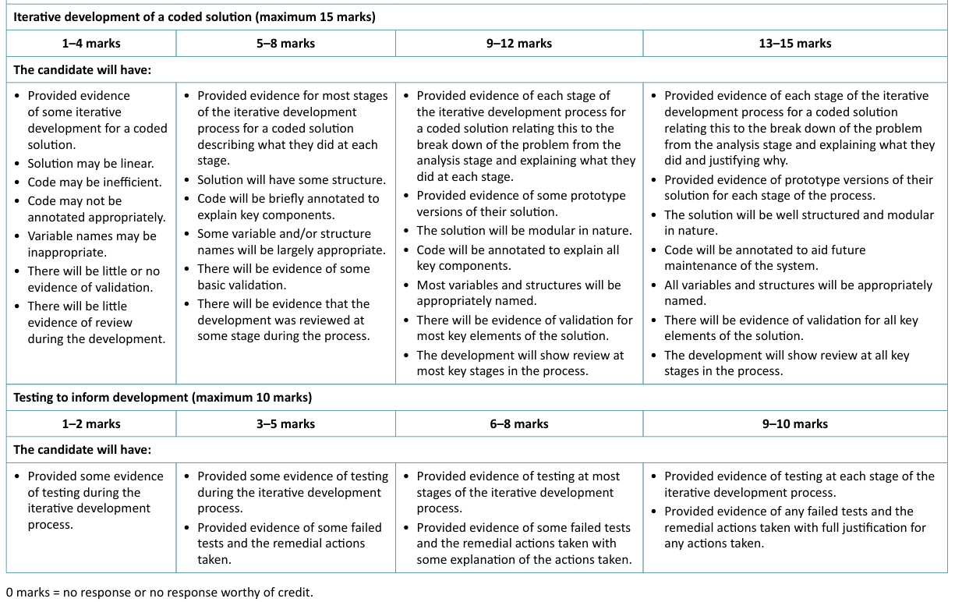
Development Phase

Slide 2
Development
BUILD → EXPLAIN → JUSTIFY → TEST → IDENTIFY A PROBLEM → CHANGE → RETEST
Developing the coded solution (OCR) — Isaac Computer Science

Slide 3
Development Structure
A suggested layout for this section of the NEA report would be:
Prototype/Iteration 1 of Module X of your solution:
Your code should be fully annotated (#comments).
It should be clear how the evidence links to your solution’s structure i.e. top down module design
It should be clear which requirement/s the given code is trying to address.
Iterative Testing:
Each module should then be tested.
You should include your test plan for that module from your design section.
The results of testing should be clearly shown and discussed
Any failed tests should be highlighted ready for remedial action.
Repeat:
These stages should be repeated until the requirement are met and the module is fully functional
Prototype/Iteration 2 of Module X of your solution:
As above but highlight any remedial action taken

Slide 4
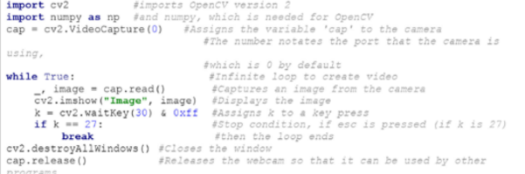
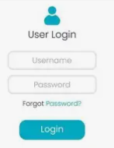


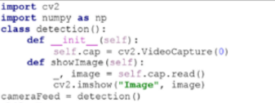
Development Structure
Module - User Management
Iterative Testing 1 with Prototype

Slide 5
Development Structure
Further consideration needs to be given to your solution’s code evidence:
  The solution should be well structured i.e. module in nature (use functions & procedures/classes).
  Code should be fully annotated i.e. a self-documenting program with clear consideration of future maintenance.
  All identifiers (variables/functions/procedures/data structures) should be appropriately named.
  A separate section which provides evidence of the solution’s validation routines should be present.
  The modules of your coded solution should be clearly laid out i.e. blocked with indentation (where required).

